Slide 1

Why REST Webservices, Introduction to RMM, Introduction to Spring Boot performing POST, GET, DELETE, PUT, PATCH
Java Full Stack Program

Slide 2
Introduction to RESTful Web Services
REST stands for REpresentational State Transfer.
It is developed by Roy Thomas Fielding, who also developed HTTP.
The main goal of RESTful web services is to make web services more effective.
RESTful web services try to define services using the different concepts that are already present in HTTP.
REST is an architectural approach, not a protocol.
It does not define the standard message exchange format.
We can build REST services with both XML and JSON.
JSON is more popular format with REST.
The key abstraction is a resource in REST.
A resource can be anything.
It can be accessed through a Uniform Resource Identifier (URI).
Java Full Stack Program

Slide 3
For example:
The resource has representations like XML, HTML, and JSON.
The current state capture by representational resource.
When we request a resource, we provide the representation of the resource.
The important methods of HTTP are:
GET: It reads a resource.
PUT: It updates an existing resource.
POST: It creates a new resource.
DELETE: It deletes the resource.
Java Full Stack Program

Slide 4
For example, if we want to perform the following actions in the social media application, we get the corresponding results.
POST /users: It creates a user.
GET /users/{id}: It retrieves the detail of a user.
GET /users: It retrieves the detail of all users.
DELETE /users: It deletes all users.
DELETE /users/{id}: It deletes a user.
GET /users/{id}/posts/post_id: It retrieve the detail of a specific post.
POST / users/{id}/ posts: It creates a post of the user.
Java Full Stack Program

Slide 5
HTTP also defines the following standard status code:
404: RESOURCE NOT FOUND
200: SUCCESS
201: CREATED
401: UNAUTHORIZED
500: SERVER ERROR
RESTful Service Constraints
There must be a service producer and service consumer.
The service is stateless.
The service result must be cacheable.
The interface is uniform and exposing resources.
The service should assume a layered architecture.
Java Full Stack Program

Slide 6
Advantages of RESTful web services
RESTful web services are platform-independent.
It can be written in any programming language and can be executed on any platform.
It provides different data format like JSON, text, HTML, and XML.
It is fast in comparison to SOAP because there is no strict specification like SOAP.
These are reusable.
They are language neutral.
Java Full Stack Program

Slide 7
Principles of RESTful applications:
1. URI Resource Identification:
A RESTful web service should have a set of resources that can be used to select targets of interactions with clients.
These resources can be identified by URI (Uniform Resource Identifiers).
The URIs provide a global addressing space and help with service discovery.
2. Uniform Interface:
Resources should have a uniform or fixed set of operations, such as PUT, GET, POST, and DELETE operations.
This is a key principle that differentiates between a REST web service and a non-REST web service.
Java Full Stack Program

Slide 8
Self-Descriptive Messages:
As resources are decoupled from their representation, content can be accessed through a large number of formats like HTML, PDF, JPEG, XML, plain text, JSON, etc.
The metadata of the resource can be used for various purposes like control caching, detecting transmission errors, finding the appropriate representation format, and performing authentication or access control.
Use of Hyperlinks for State Interactions:
In REST, interactions with a resource are stateless, that is, request messages are self-contained.
So explicit state transfer concept is used to provide stateful interactions.
URI rewriting, cookies, and form fields can be used to implement the exchange of state.
A state can also be embedded in response messages and can be used to point to valid future states of interaction.
Java Full Stack Program

Slide 9
What is RMM?
Richardson Maturity Model
Richardson Maturity Model grades API by their RESTful maturity. It is proposed by Leonard Richardson.
The Richardson maturity model is a way to grade your API according to the constraints of REST.
It breaks down the principal element of the REST approach into four levels (0 to 3).
There are four levels:
Level 0: The Swamp of POX
Level 1: Resources
Level 2: HTTP Verbs
Level 3: Hypermedia Control
Java Full Stack Program

Slide 10
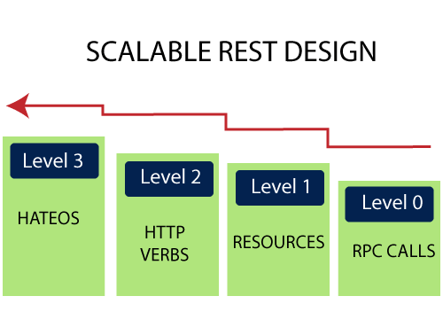
For example, a level higher is more RESTful compared to one that is at a lower level. Only when an API reaches level 4, we consider it as a RESTful API.
Java Full Stack Program

Slide 11
Level 0: The Swamp of POX
Level 0 is also known as POX (Plain Old XML).
At level 0, HTTP is used only as a transport protocol that is used as a remote interaction.
It does not take the advantages of HTTP like different HTTP methods, and HTTP cache.
To get and post the data, we send a request to the same URI, and only the POST method may be used.
These APIs use only one URI and one HTTP method called POST.
In short, it exposes SOAP web services in the REST style.
For example,
There can be many customers for a particular company.
For all the different customers, we have only one endpoint. To do any of the operations like get, delete, update, we use the same POST method.
To get the data: http://localhost:8080/customer
To post the data: http://localhost:8080/customer
In the above two URIs, we have used the same URI and method to get and post the customers.
Java Full Stack Program

Slide 12
Level 1: Resources
When an API can distinguish between different resources, it might be at level 1.
It uses multiple URIs.
Where every URI is the entry point to a specific resource.
It exposes resources with proper URI. Level 1 tackles complexity by breaking down huge service endpoints into multiple different endpoints.
It also uses only one HTTP method POST for retrieving and creating data.
For example, if we want a list of specific products, we go through the URI http://localhost:8080/products.
If we want a specific product, we go through the URI http://localhost:8080/products/mobile.
Java Full Stack Program

Slide 13
Remember the following points while building a URI:
Use domain and subdomain to logically group or partition resources.
Use / to indicate a hierarchical relationship.
Use , and ; to indicate non-hierarchical relationships.
Use - and _ to improve the readability.
Use & to separate parameters.
Avoid including file extensions.
Java Full Stack Program

Slide 14
Level 2: HTTP Verbs
Level 2 indicates that an API must use the protocol properties to deal with scalability and failures.
At level 2, correct HTTP verbs are used with each request.
It suggests that in order to be truly RESTful, HTTP verbs must be used in API.
For each of those requests, the correct HTTP response code is provided.
We don't use a single POST method for all requests.
We use the GET method when we request a resource, and use the DELETE method when we want to delete a resource.
Also, use the response codes of the application protocol.
For example, to get the customers, we send a request with the URI http://localhost:8080/customers, and the server sends proper response 200 OK.
Java Full Stack Program

Slide 15
Level 3: Hypermedia Controls
Level 3 is the highest level.
It is the combination of level 2 and HATEOAS.
It also provides support for HATEOAS. It is helpful in self-documentation.
For example,
if we send a GET request for customers, we will get a response for customers in JSON format with self-documenting Hypermedia.
Java Full Stack Program

Slide 16
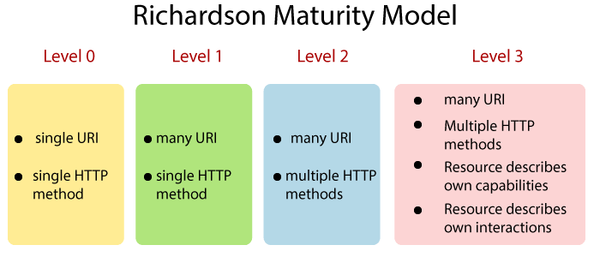
The following figure shows the overview of the model:
Java Full Stack Program

Slide 17
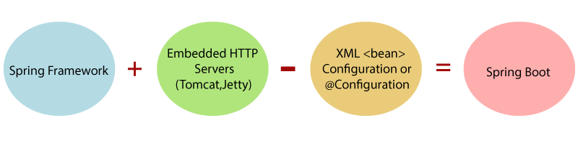
What is Spring Boot?
Spring Boot is a project that is built on the top of the Spring Framework.
It provides an easier and faster way to set up, configure, and run both simple and web-based applications.
It is a Spring module that provides the RAD (Rapid Application Development) feature to the Spring Framework.
It is used to create a stand-alone Spring-based application that you can just run because it needs minimal Spring configuration.
In short, Spring Boot is the combination of Spring Framework and Embedded Servers.
Java Full Stack Program

Slide 18
Introduction to Spring Boot perfuming POST
What is Spring Boot POST?
Spring Boot POST is a feature of the Spring Boot framework for implementing HTTP POST requests in web applications.
The HTTP POST method is used to submit data to a web server for processing, typically to create a new resource on the server.
Spring Boot makes it easy to handle HTTP POST requests by providing annotations such as @PostMapping and @RequestBody.
These annotations allow you to quickly create a RESTful web service that can handle POST requests from clients.
To implement a POST request in Spring Boot, you would typically define a controller class that is annotated with @RestController.
Inside the controller class, you would define a method that is annotated with @PostMapping to handle the incoming POST request.
Java Full Stack Program

Slide 19
For example, here's a simple Spring Boot controller that handles a POST request to create a new user resource:
@RestController
public class UserController {
@PostMapping("/users")
public ResponseEntity<User> createUser(@RequestBody User user) {
// Persist the user to the database
userRepository.save(user);
// Return the saved user with a 201 CREATED status code
return ResponseEntity.status(HttpStatus.CREATED).body(user);
}
}
Java Full Stack Program

Slide 20
In this example, the @PostMapping annotation specifies that the createUser method should handle incoming POST requests to the /users endpoint.
The @RequestBody annotation indicates that the User object should be deserialized from the request body, and passed as an argument to the method.
Inside the method, the userRepository object is used to persist the new user to the database. Finally, the saved user is returned to the client with a 201 CREATED status code using the ResponseEntity class.
By using Spring Boot's built-in support for HTTP POST requests, you can easily create a RESTful web service that can handle incoming data submissions and create new resources on the server.
Java Full Stack Program

Slide 21
What is GET?
In Spring Boot, GET is an HTTP method used to retrieve data from a server.
It is commonly used in RESTful web services to retrieve resources from the server, such as retrieving a user's profile or a list of products.
To handle GET requests in Spring Boot, you can create a method in a controller class and annotate it with @GetMapping. For example:
@RestController
public class UserController {
@GetMapping("/users")
public List<User> getUsers() {
// code to retrieve a list of users from the server
}
@GetMapping("/users/{id}")
public User getUserById(@PathVariable Long id) {
// code to retrieve a user by ID from the server
}
}
Java Full Stack Program

Slide 22
In the above example, @GetMapping("/users") creates an endpoint at the URL /users that accepts GET requests.
When a GET request is made to this endpoint, the getUsers() method will be called and should return a list of User objects.
@GetMapping("/users/{id}") creates an endpoint at the URL /users/{id} that accepts GET requests with a variable id.
When a GET request is made to this endpoint, the getUserById() method will be called and should return the User object with the given ID.
Spring Boot automatically maps the URL parameters to the corresponding method parameters.
In the getUserById() method, @PathVariable Long id maps the id parameter in the URL to the id parameter in the method signature.
Java Full Stack Program

Slide 23
What is DELETE?
In Spring Boot, DELETE is an HTTP method used to delete resources on the server.
It is commonly used in RESTful web services to delete a specific resource, such as deleting a user's profile or a product from a catalog.
To handle DELETE requests in Spring Boot, you can create a method in a controller class and annotate it with @DeleteMapping. For example:
@RestController
public class UserController {
@DeleteMapping("/users/{id}")
public void deleteUserById(@PathVariable Long id) {
// code to delete a user by ID from the server
}
}
Java Full Stack Program

Slide 24
In the above example, @DeleteMapping("/users/{id}") creates an endpoint at the URL /users/{id} that accepts DELETE requests with a variable id.
When a DELETE request is made to this endpoint, the deleteUserById() method will be called and should delete the user with the given ID from the server.
Spring Boot automatically maps the URL parameters to the corresponding method parameters.
In the deleteUserById() method, @PathVariable Long id maps the id parameter in the URL to the id parameter in the method signature.
Java Full Stack Program

Slide 25
What is PUT ?
In Spring Boot, PUT is an HTTP method used to update an existing resource.
It is part of the RESTful web services architecture, which uses HTTP methods to perform CRUD (Create, Read, Update, Delete) operations on resources.
In Spring Boot, you can use the @PutMapping annotation to handle PUT requests.
This annotation is used to map HTTP PUT requests onto specific handler methods.
The handler method can then update the resource with the data provided in the request payload.
Java Full Stack Program

Slide 26
Here is an example of using the @PutMapping annotation in Spring Boot:
@RestController
@RequestMapping("/employees")
public class EmployeeController {
@Autowired
private EmployeeRepository employeeRepository;
@PutMapping("/{id}")
public ResponseEntity<Employee> updateEmployee(@PathVariable Long id, @RequestBody Employee employeeDetails) {
Employee employee = employeeRepository.findById(id)
.orElseThrow(() -> new ResourceNotFoundException("Employee not found for this id :: " + id));
employee.setName(employeeDetails.getName());
employee.setEmail(employeeDetails.getEmail());
employee.setPhone(employeeDetails.getPhone());
final Employee updatedEmployee = employeeRepository.save(employee);
return ResponseEntity.ok(updatedEmployee);
}
}
Java Full Stack Program

Slide 27
In this example, the @PutMapping annotation is used to map the HTTP PUT request to the "updateEmployee" method.
The method takes in the resource ID as a path variable and the updated resource data as a request body.
It then updates the resource in the database using the EmployeeRepository and returns the updated resource in the response body.
Java Full Stack Program

Slide 28
What is PATCH ?
In Spring Boot, PATCH is an HTTP method used to partially update an existing resource.
Unlike PUT, which requires the entire resource to be updated, PATCH allows you to update only specific fields or attributes of a resource, leaving the rest of the resource unchanged.
In Spring Boot, you can use the @PatchMapping annotation to handle PATCH requests.
This annotation is used to map HTTP PATCH requests onto specific handler methods.
The handler method can then update the resource with the data provided in the request payload.
Java Full Stack Program

Slide 29
THANK YOU
Java Full Stack Program

